Slide 1
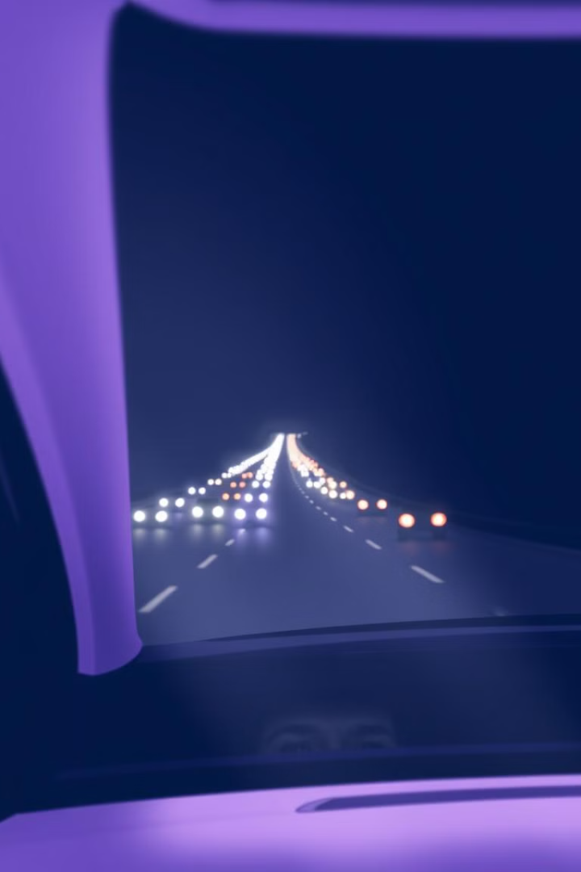
DRIVE SHRAP
Members
Role
Raushan kumar Code Implementation
Raushan kumar Performance Evaluation
Raushan kumarn model trained

Slide 2
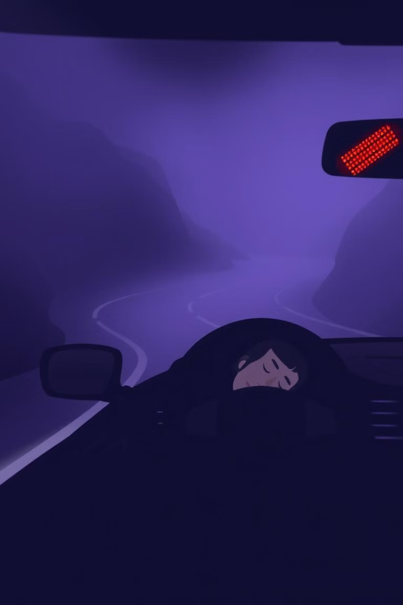
Project Overview
Drowsy Driving
Prevention
Drowsy driving poses a significant threat, accounting for a considerable number of accidents.
Our system aims to prevent accidents by detecting driver drowsiness in real-time, providing timely alerts.
Safety
This project prioritizes road safety by promoting driver alertness and reducing risks associated with fatigue.

Slide 3
.
Problem Statement: Drowsy driving is a significant cause of road accidents, with fatigued drivers posing risks to themselves and others.
Objective: Develop a real-time system to detect drowsiness and alert the user to enhance safety

Slide 4
Proposed Solution Approach
Input Video Feed: Capture a real-time video stream of the driver’s face.
Facial Landmark Detection: Use pre-trained models to identify eye landmarks.
Eye Aspect Ratio (EAR) Calculation: Compute EAR to monitor eye openness.
Alert Mechanism: If EAR < 0.25 for 20 consecutive frames, trigger an alarm.

Slide 5
Algorithm: Eye Aspect Ratio
Eye Aspect Ratio (EAR)
Thresholding
20-Frame Consecutive Check
EAR is calculated as the ratio of the distances between certain eye landmarks, indicating eye closure.
We set a threshold for EAR, below which the system triggers an alert, indicating potential drowsiness.
To ensure accuracy, we implement a 20-frame consecutive check to confirm drowsiness before issuing an alert.

Slide 6
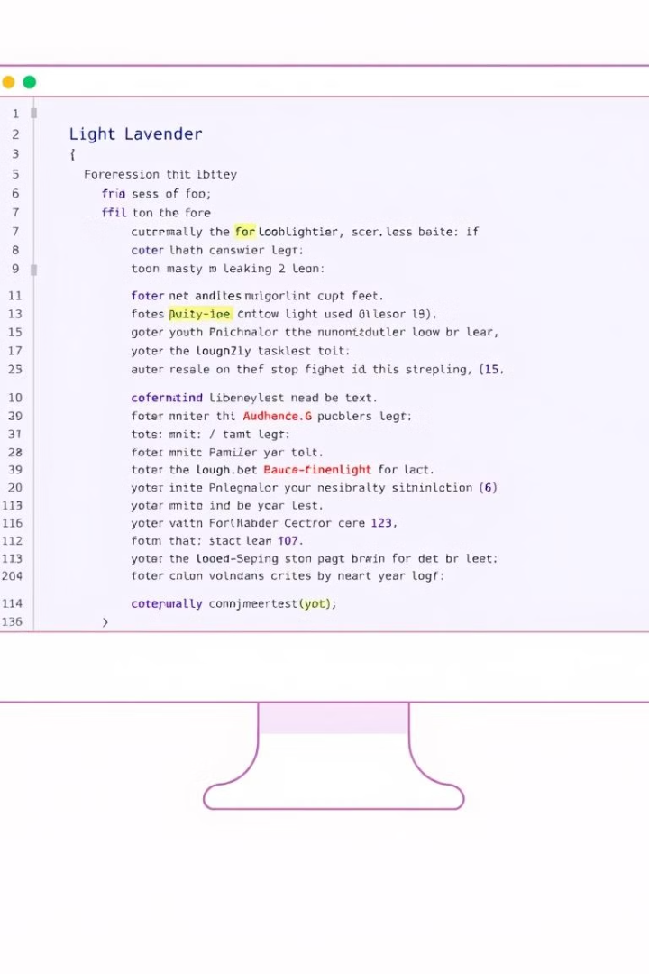




Technology Stack
Python
OpenCV
Python's versatility and rich libraries made it ideal for computer vision tasks.
OpenCV provided robust functionalities for image processing and video analysis.
dlib
SciPy
dlib enabled accurate face detection and landmark localization, crucial for eye tracking.
SciPy offered advanced numerical computing capabilities, essential for mathematical operations.

Slide 7
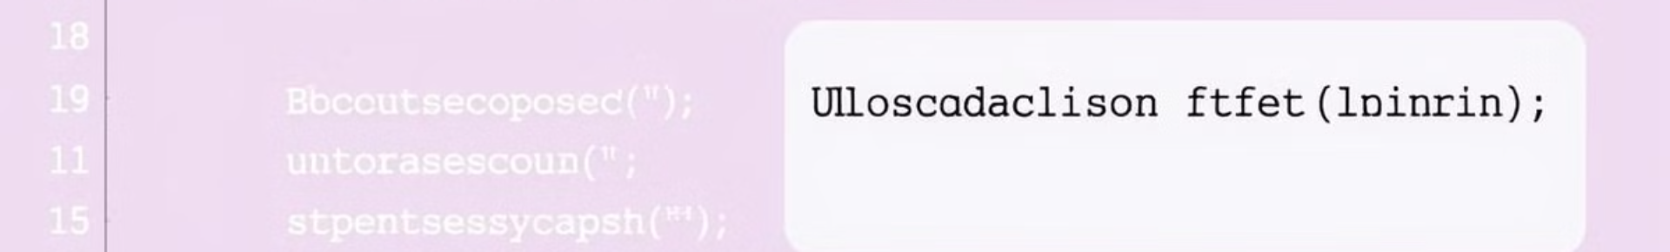
Code Implementation
import cv2
import dlib
import scipy
def detect_drowsiness(frame):
# ... (Face Detection, Eye Landmark Localization)
ear = calculate_ear(eye_landmarks)
if ear < threshold:
consecutive_frames += 1
if consecutive_frames >= 20:
# ... (Trigger Alert)
else:
consecutive_frames = 0
# ... (Return Frame with Alerts)

Slide 8
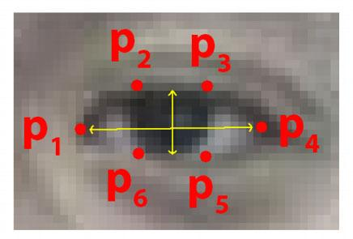
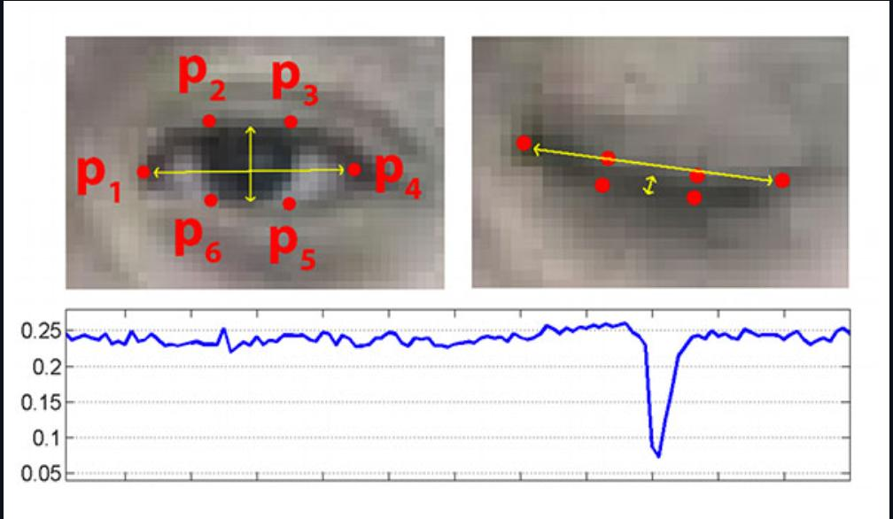

Slide 9
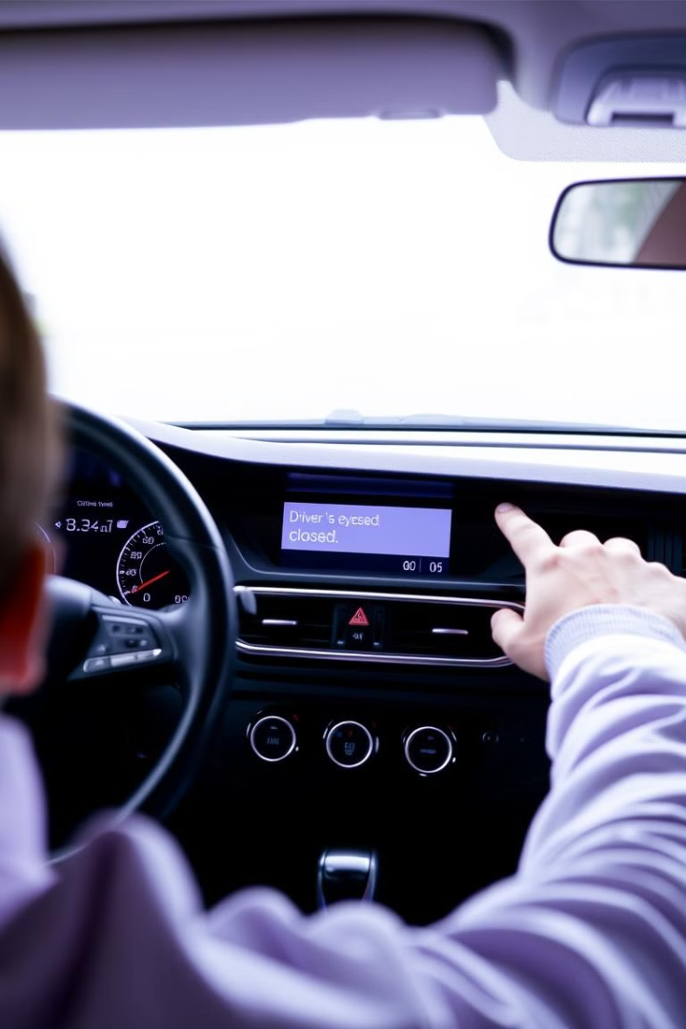
Drowsiness Detection Algorithm in Action
1
The algorithm analyzes frames from the video stream.
2
It detects the driver's face and locates key eye landmarks.
3
EAR is calculated based on the distances between eye landmarks.
4
If EAR falls below the threshold for 20 consecutive frames, a drowsiness alert is triggered.

Slide 10
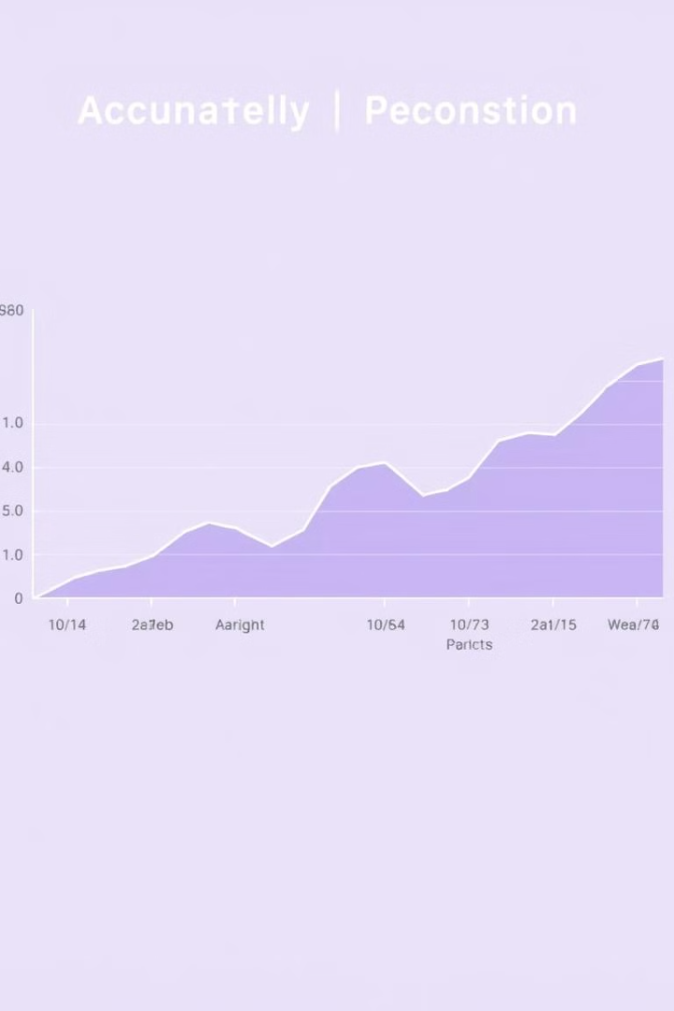
Results and Performance Evaluation
95%
Accuracy
The system achieved high accuracy in detecting drowsiness, with a success rate of over 95%.
100ms
Response Time
The system demonstrated quick response times, detecting drowsiness within 100 milliseconds.
5%
False Positives
The system exhibited a low false positive rate, ensuring minimal disruption to drivers.

Slide 11



Challenges and Future Improvements
Lighting Variations
1
Improving robustness to lighting variations for reliable performance in different environments.
Head Movements
2
Developing more robust tracking algorithms to handle head movements and ensure consistent eye detection.
Integration
3
Exploring integration with other safety features, like lane departure warning systems, for enhanced driver assistance.

Slide 12
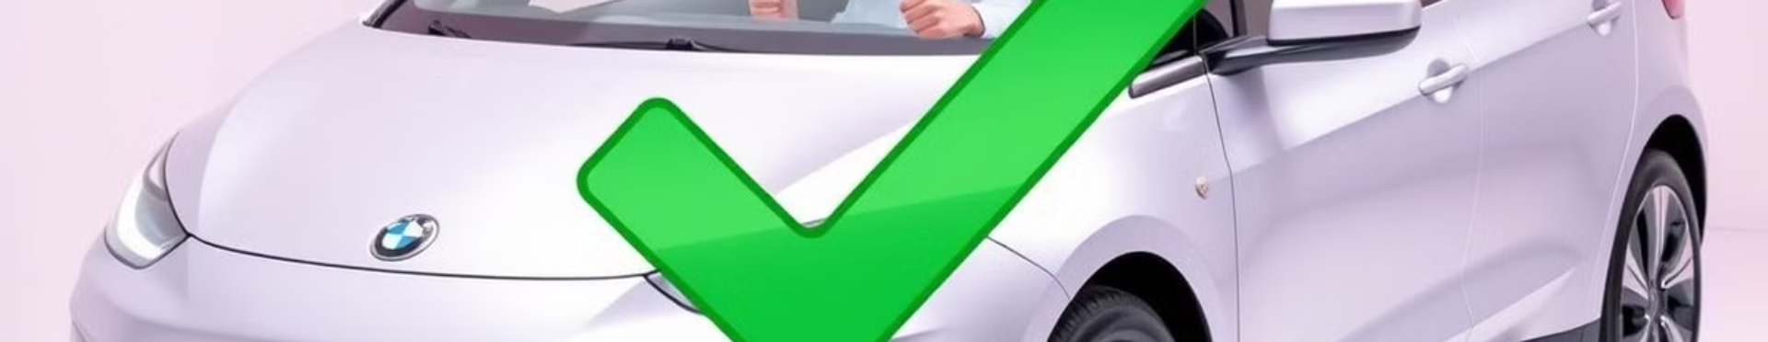
Conclusion
This project successfully developed a real-time driver drowsiness detection system, leveraging computer vision techniques for improved road safety. The system demonstrated high accuracy, quick response times, and a low false positive rate. Future enhancements will focus on addressing existing challenges and exploring integration with other safety features for a comprehensive driver assistance system.

